Slide 1




Activities and Intent
By
Dr. Anu Sahni
anu.sahni@ncirl.ie

Slide 2
Intent
Intents are used to:
Explicitly start a particular activity or service
Start an activity or service that performs certain specified action
Broadcast when an event occurs
Intents may use data that are required by the activity or service that would start
Intents may return result from the called activity or service.

Slide 3
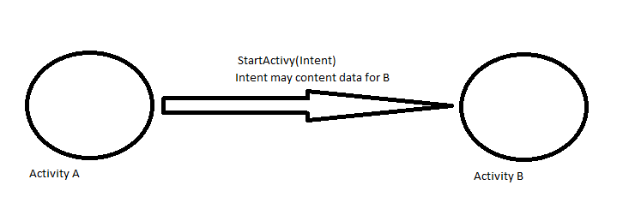
Intents
The intent
Contains the class to be “called” by the activity
And may contain other information needed by that class (Activity, service, Broadcast receiver, etc)

Slide 4
Intent
Start an Activity
A button click starts a new Activity for text entry
Clicking Share opens an app that allows you to post a photo
Start an Service
Initiate downloading a file in the background
Deliver Broadcast
The system informs everybody that the phone is now charging

Slide 5
Intent
There are two primary forms of intents you will use.
Explicit Intents have specified a component (via setComponent(ComponentName) or setClass(Context, Class)), which provides the exact class to be run. Often these will not include any other information, simply being a way for an application to launch various internal activities it has as the user interacts with the application.
Implicit Intents have not specified a component; instead, they must include enough information for the system to determine which of the available components is best to run for that intent.

Slide 6
Intent
Create a new instance of Intent and pass the context and the activity class to be launched. For example,
Intent intent = new Intent(getApplicationContext(), activity name.class)
Call the startActivity() method in the calling activity java file.
This new instance of intent is passed as an argument to the startActivity() method as below:
startActivity(intent);
Note 1: activity name should be replaced by the name of the activity to be started suffixed with .class
e.g. if Activity2 is to be started then
Intent intent = new Intent(getApplicationContext(), Activity2.class);
startActivity(intent);
Note 2: this activity should be added to the AndroidManifest.xml.

Slide 7
Intent
Passing data using Intent object
Sometime you need to pass data to an activity. Use the Intent object to carry the data to the target activity.
Use ‘putExtra(key name, value) method in the calling activity to send data.
The data has to be of the same type in calling and target activity.
Use ‘getExtra(key, value) in the target activity to receive data.

Slide 8
Passing data to a new activity.
Create an intent
Intent i = new Intent(this, ActivityTwo.class);
i.putExtra(“key1”, “Some data”);
i.putExtra(“key2”, “more data”);
Where key1, key2 are key names for the values that are being passed.

Slide 9
Passing data to a new activity. (2)
ActivityTwo
In the onCreate method
Bundle extras = getIntent().getExtras();
//Make sure the activity was called correctly.
if (extras == null) {return;}
String value1 = extras.getString(“key1");
String value2 = extras.getString(“key2");
many getX methods, like getInt(String key) are available.

Slide 10
Intent
Implicit Intents have not specified a component; instead, they must include enough information for the system to determine which of the available components is best to run for that intent.
Calling Built-in apps using intents (implicit intent)
You create an intent and in the constructor, the action name is passed as an argument. E.g.
Intent intent = new Intent(Intent.ACTION_CALL);
The intent is passed to the Android system who checks other activities intent-filter that can perform this action
You can call many built-in apps included with an Android device by using intents. For example, the app needs to enable the user to select a person from Contacts and call that person. Intents can be used to bring up the Contacts application from which you can select the person to call.
Advantage – no building of another app and good user experience.

Slide 11
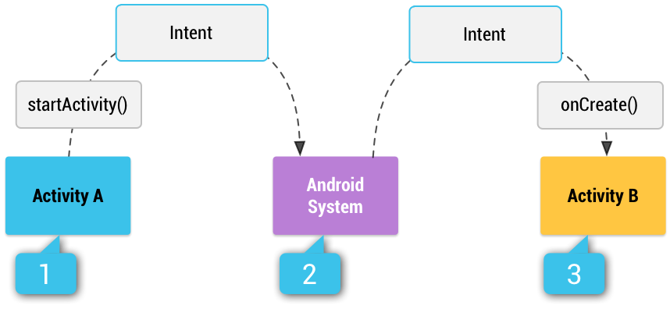
Intent

Slide 12
Intent
Intents usually come in the pair – action and data. Action specifies what needs to be done such as launching browser. Data is what the action performed on such as a URL so that the URL is opened when the browser is launched. In the following example launches the existing call activity (action call) which places a call to the number passed as data. Permission needs to be specified in Manifest.
Uri number = Uri.parse("tel:014498500");
Intent callIntent = new Intent(Intent.ACTION_CALL, number);
In order to enable other activities to call your activity, you need to specify the action and category within the <intent-filter> element in AndroidManifest.xml.
This can be done by
Setting <intent-filter> action and category in AndroidManifest.xml as given below:
<intent-filter>
<action android:name=“activity name with full path in reverse order” />
<category android:name=“android.intent.category.name” />
</intent-filter>

Slide 13
Intent
Resolving Intent Filter Collision
If two activities have the same filter name, there will be collision when the calling activity invokes startActivity() method and passing intent with the same name.
For example, there are 2 activities – Activity 2 and Activity 3 but the intent-filter name is same for both – Activity2 and both of them have the same path since they lie in the same project. The command will be same in the calling activity whether Activity 2 or Activity 3 is called because you pass the intent-filter name which is the same for both.
The Android OS will display a selection of both these activities.
If you check the “Use by default for this action”, the next time you will not be given any choice and the activity you selected the first time will start. To get the choice each time, go to Settings → Applications→ Manage applications and select the application name . Scroll down on the app screen and click Clear defaults.

Slide 14
Implicit Intent
Request action
System checks which apps can perform that action
Lets anonymous app component service action requests.
Intent iintent = new Intent(Intent.ACTION_DIAL, Uri.parse “tel:1234567”);
startActivity(iintent);

Slide 15
Intent
An intent object can contain the following information:
Action: A string that specifies the generic action to perform (such as view or pick).
Data: The URI (a Uri object) that references the data to be acted on and/or the MIME type of that data. The type of data supplied is generally dictated by the intent's action. For example, if the action is ACTION_EDIT, the data should contain the URI of the document to edit.

Slide 16
Intent
An intent object can contain the following information:
Category: A string containing additional information about the kind of component that should handle the intent. Any number of category descriptions can be placed in an intent, but most intents do not require a category. Here are some common categories: browsable, CATEGORY_BROWSABLE, CATEGORY_LAUNCHER
Extras:Key-value pairs that carry additional information required to accomplish the requested action. Just as some actions use particular kinds of data URIs, some actions also use particular extras.

Slide 17
Standard Activity Actions
These are the current standard actions that Intent defines for launching activities (usually through startActivity(Intent).
ACTION_MAIN
ACTION_VIEW
ACTION_ATTACH_DATA
ACTION_EDIT
ACTION_PICK
ACTION_CHOOSER
ACTION_GET_CONTENT
ACTION_DIAL

Slide 18
Standard Activity Actions
ACTION_CALL
ACTION_SEND
ACTION_SENDTO
ACTION_ANSWER
ACTION_INSERT
ACTION_DELETE
ACTION_RUN
ACTION_SYNC
ACTION_PICK_ACTIVITY
ACTION_SEARCH
ACTION_WEB_SEARCH
ACTION_FACTORY_TEST

Slide 19
Standard Categories
These are the current standard categories that can be used to further clarify an Intent via addCategory(String).
CATEGORY_DEFAULT
CATEGORY_BROWSABLE
CATEGORY_TAB
CATEGORY_ALTERNATIVE
CATEGORY_SELECTED_ALTERNATIVE
CATEGORY_LAUNCHER
CATEGORY_INFO

Slide 20
Standard Categories
CATEGORY_HOME
CATEGORY_PREFERENCE
CATEGORY_TEST
CATEGORY_CAR_DOCK
CATEGORY_DESK_DOCK
CATEGORY_LE_DESK_DOCK
CATEGORY_HE_DESK_DOCK
CATEGORY_CAR_MODE
CATEGORY_APP_MARKET

Slide 21
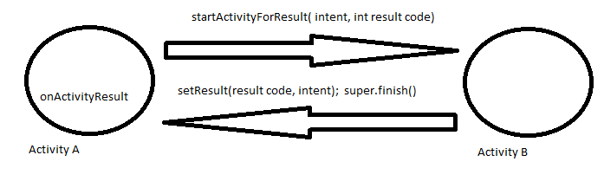
Returning data.
If we want target activity to return data to the calling use the following method instead of startActivity(intent)
startActivityForResult(intent, requestCode);
The request_Code is an integer that identifies the called activity. This identifier is needed so that the you must know which activity is returning this value in case multiple activities are called.
Override onActivityResult(int requestCode, int resultCode, Intent data) method.
Note 1: if the request code is set to -1, no result is returned back and it is same as startActivity() method.

Slide 22
Return data
In order to send the data back to the calling activity, use an Intent object to send data back via the setData() method in the activity source file and as below:
Intent data = new Intent();
…
data.setData(the data to be sent back);
Use setResult() method to send the result code such as ok or cancel and the data as shown below:
setResult(RESULT_OK, data);
finish();
Close the activity by calling the finish() method so that the control goes back to the calling activity.

Slide 23
Return data.
When activityTwo finishes, it can return an Intent with data.
In the finish() method
@Override
public void finish() {
Intent data = new Intent();
data.putExtra("returnKey1", “some data ");
data.putExtra("returnKey2", “more data");
setResult(RESULT_OK, data);
super.finish();
}
Result: constants are RESULT_OK, RESULT_CANCELED, but you can also use any custom result with an int.
When an activity fails, crashes, the result will be RESULT_CANCELED.

